Slide 1
SCRUM UPDATE4
ROS2 Object Detection and Tracking in field Autonomous Vehicles

Slide 2
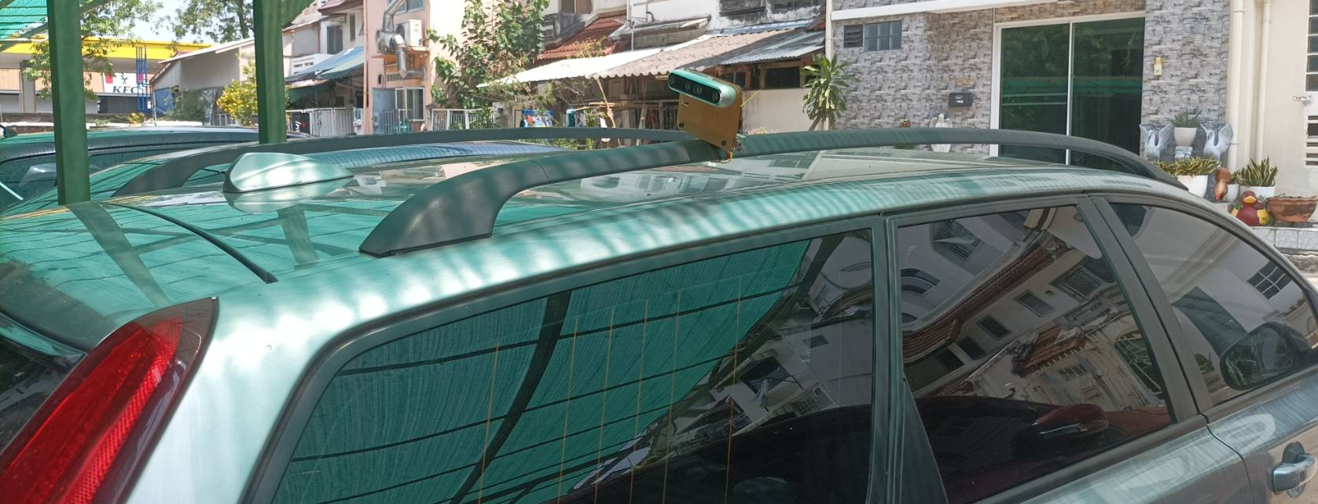
Record

Slide 3

Scrum 4 Testing

Slide 4
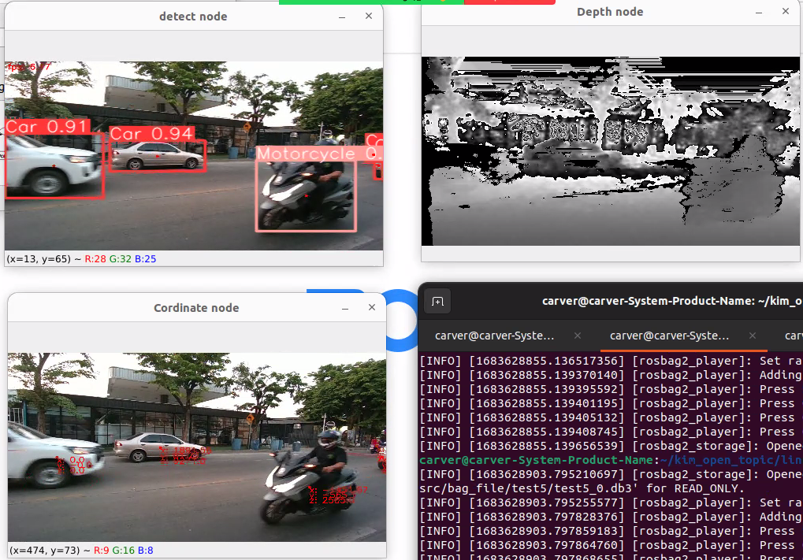

Testing node

Slide 5
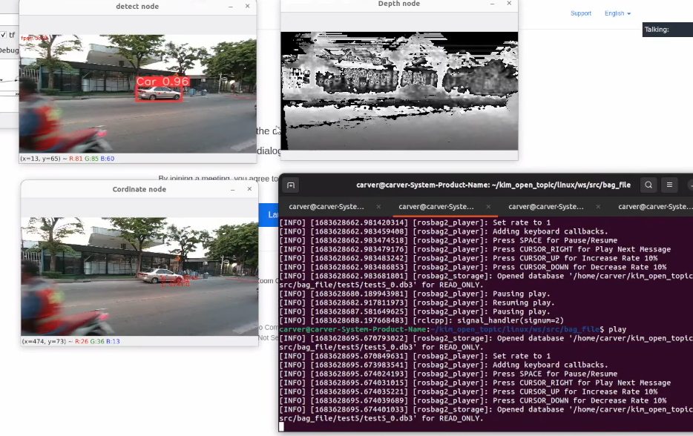
Testing node
Run real time จะเกิดการ delay

Slide 6
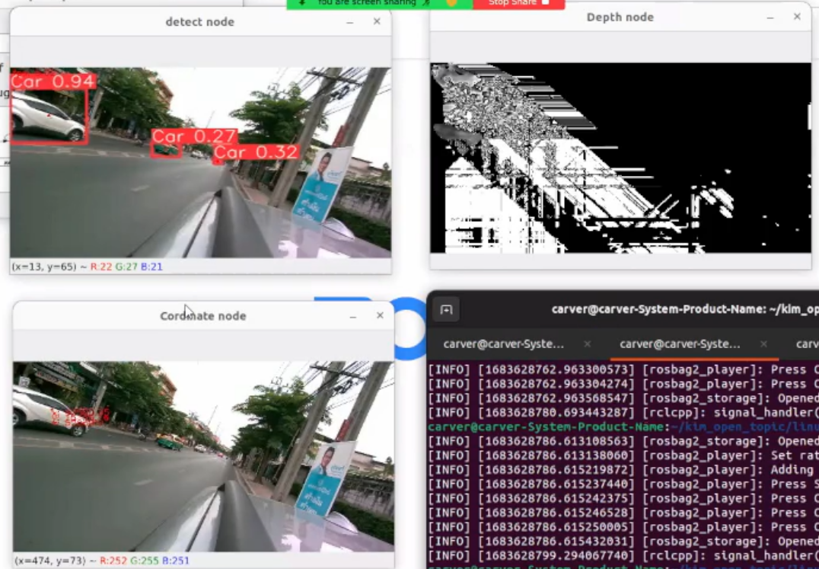
Testing node fail

Slide 7
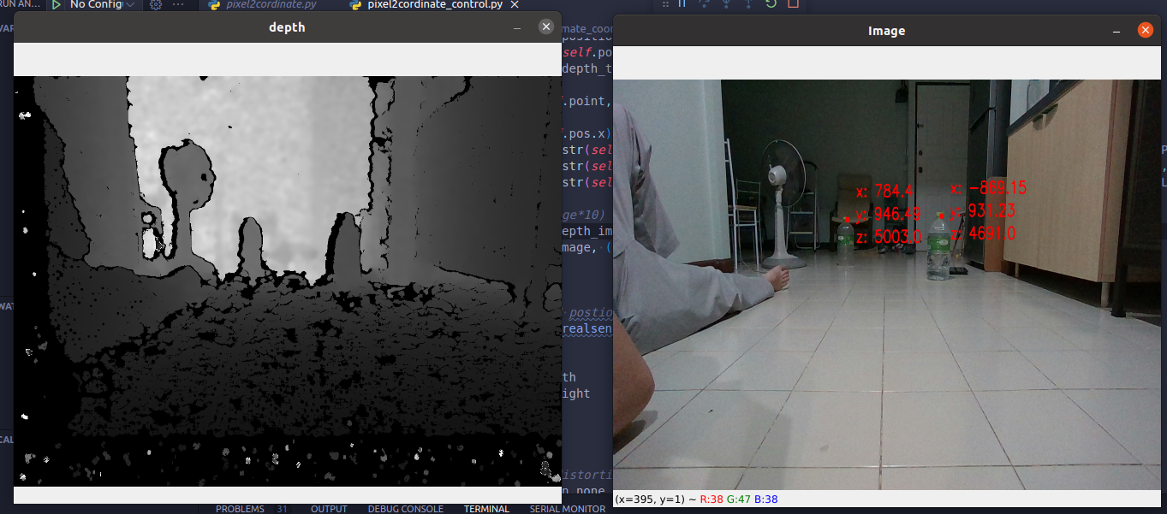
Testing camera

Slide 8
Testing camera
mm | x ความกว้าง | Y ความสูง | z ความลึก
1st Real | 780 | 360 | 560
1st Testing | 784 (+4) | 946 (+586) | 500 (-60)
2nd Real | -820 | 360 | 400
2nd Testing | -869 (+39) | 931 (+571) | 469 (+60)

